Slide 1

In the loop

Slide 2




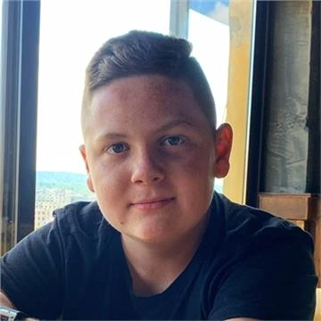
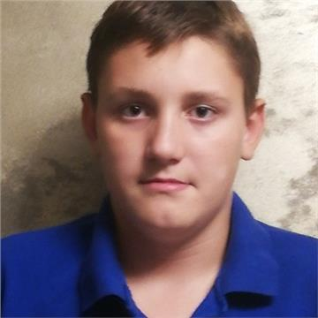

Yoan Panov BackEnd
Our team
Georgi Dimov
BackEnd
Anton Goreshtilov
ScrumTrainer
Nikolay Zabirov
QA Engineer

Slide 3
O U R I D E A

Slide 4



Stages of development
3.
1.
2.

Slide 5







The programs we used

Slide 6
Let’s jump to the project!

